Slide 1
Example of a string graph assembly
Genome AACATAAAAAAAGACGAAAAAAACGTC
Reads R1:AACATAA R2:ATAAAAA R3:AAAAAAG R4:AAGACGA R5:GACGAAA R6:AAAAAAA R7:AAACGTC
String graph:
Overlaps (min 3):
R1 R2 4
R2 R3 5
R2 R6 5
R2 R7 3
R3 R4 3
R3 R5 3
R3 R6 6
R4 R5 5
R5 R6 3
R5 R7 3
R6 R7 3
AACAT
CGTC
AAAAAAA
GCAG

Slide 2
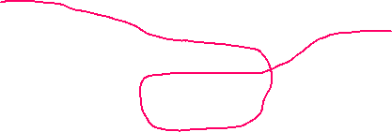
Example of a string graph assembly
Genome AACATAAAAAAAGACGAAAAAAACGTC
Reads R1:AACATAA R2:ATAAAAA R3:AAAAAAG R4:AAGACGA R5:GACGAAA R6:AAAAAAA R7:AAACGTC
String graph: assembly
Overlaps (min 3):
R1 R2 4
R2 R3 5
R2 R6 5
R2 R7 3
R3 R4 3
R3 R5 3
R3 R6 6
R4 R5 5
R5 R6 3
R5 R7 3
R6 R7 3
AACAT
CGTC
AAAAAAA
GCAG

Slide 3

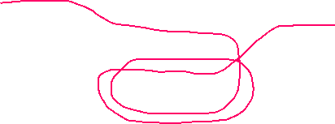
Example of a string graph assembly
Genome AACATAAAAAAAGACGAAAAAAACGTC
String graph: assembly
Genome AACATAAAAAAAGACGAAAAAAAGACGAAAAAAACGTC produces the same graph:
AACAT
CGTC
AAAAAAA
GCAG
AACAT
CGTC
AAAAAAA
Can use coverage to estimate repeat multiplicity
GCAG

Slide 4
Consensus
Reads have errors, overlaps are typically not perfect
In each contig we need to compute consensus sequence
AGATAGACATAGACATAGACAGATACAC ATAGACACAGACTATAGGCAGATACACTCGAT GACATAGACATAGACAGGATACGCTCG ACATAGACATAGACAGGATACACTCGA TAGACAGGATACACTCGATCGGGT

Slide 5
Computing consensus sequence
Reads have errors, overlaps are typically not perfect
Produce multi-alignment
AGATAGACATAGAC-ATAGACAG-ATACAC ATAGACACAGACTATAGGCAG-ATACACTCGAT GACATAGAC-ATAGACAGGATACGCTCG ACATAGAC-ATAGACAGGATACACTCGA TAGACAGGATACACTCGATCGGGT

Slide 6
Computing consensus sequence
Reads have errors, overlaps are typically not perfect
Compute consensus sequence
AGATAGACATAGAC-ATAGACAGGATACACTCGATCGGGT
AGATAGACATAGAC-ATAGACAG-ATACAC ATAGACACAGACTATAGGCAG-ATACACTCGAT GACATAGAC-ATAGACAGGATACGCTCG ACATAGAC-ATAGACAGGATACACTCGA TAGACAGGATACACTCGATCGGGT

Slide 7
K-mer graph
Break reads into overlapping k-mers of fixed length K
e.g K=5 AGACATAGAC AGACA GACAT ACATA CATAG ATAGA TAGAC
Count all kmers in the reads, build a table of kmer-count (use canonical k-mers) AGACA 5 GACAT 20
Build k-mer graph, k-mers are nodes and k-1 exact overlaps are edges
Look for a
Eulerian path through the graph (trail that visits each edge exactly once) or
Hamiltonian path through the graph (path that visits each node exactly once)

Slide 8
K-mer graph
Build k-mer graph, k-mers are nodes and k-1 exact overlaps are edges AGACA check continuations in both directions AGACA none A A -none none C C 5 none G G 10 15 T T -none

Slide 9
K-mer graph
Build k-mer graph, k-mers are nodes and k-1 exact overlaps are edges AGACA check continuations in both directions GACAC AGACA GACAG none A
This is a forward “branch”.

Slide 10
K-mer graph
Build k-mer graph, k-mers are nodes and k-1 exact overlaps are edges AGACA check continuations in both directions GACAC AGACA none A GACAG none C none G 15 T none A
Possibly unique continuation? Check for backward branch

Slide 11
K-mer graph
Build k-mer graph, k-mers are nodes and k-1 exact overlaps are edges AGACA check continuations in both directions GACAC TAGACA none C GACAG none G none T none A
Possibly unique continuation? Check for backward branch

Slide 12
K-mer graph
Build k-mer graph, k-mers are nodes and k-1 exact overlaps are edges AGACA check continuations in both directions GACAC TAGACA none C GACAG none G none T none A
No backward branch -- continue

Slide 13
K-mer graph
Build k-mer graph, k-mers are nodes and k-1 exact overlaps are edges AGACA check continuations in both directions GACAC TAGAC AGACA none A GACAG none A

Slide 14
K-mer graph
Build k-mer graph, k-mers are nodes and k-1 exact overlaps are edges AGACA check continuations in both directions GACAC TAGACA none A GACAG none A

Slide 15
K-mer graph
Build k-mer graph, k-mers are nodes and k-1 exact overlaps are edges AGACA check continuations in both directions GACAC TAGACA none A GACAG none A
Continue

Slide 16
Prperties of the k-mer graph
Each k-mer is encountered only ONCE in the graph
An assembly that visits each edge once can collapse repeats (some edges may need to be visited more than once in loops)
Can use k-mer counts to see how many times need to go through each node

Slide 17
K-unitigs
K-unitigs are DNA sequences that correspond to strictly linear paths through K-mer graph
No forward or backward branches allowed
Can overlap exactly by K-1 bases with one or more other K-unitigs
All K-mers in k-unitigs are distinct (no K-mer is repeated twice)
A more compact representation of K-mer graph
K-unitigs are nodes
K-1 exact overlaps are edges

Slide 18
K-unitigs
Example: K=9
GATAACAAAGATAGAC ATGAGACTAAATAA
AGATAGACATAACAAGATACATCAATGAGACT
AGATACGACAATAGATAGAC ATGAGACTAAACATGAC

Slide 19
K-unitigs
Example: K=9
GATAACAAAGATAGAC ATGAGACTAAATAA
AGATAGACATAACAAGATACATCAATGAGACT
AGATACGACAATAGATAGAC ATGAGACTAAACATGAC
Four paths

Slide 20
K-unitigs
Example: K=9
GATAACAAAGATAGAC ATGAGACTAAATAA
AGATAGACATAACAAGATACATCAATGAGACT
AGATACGACAATAGATAGAC ATGAGACTAAACATGAC
Four paths

Slide 21
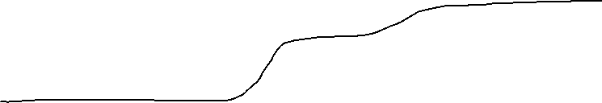
K-unitigs
Example: K=9
GATAACAAAGATAGAC ATGAGACTAAATAA
AGATAGACATAACAAGATACATCAATGAGACT
AGATACGACAATAGATAGAC ATGAGACTAAACATGAC
Four paths

Slide 22
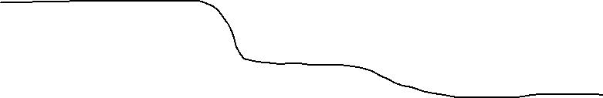
K-unitigs
Example: K=9
GATAACAAAGATAGAC ATGAGACTAAATAA
AGATAGACATAACAAGATACATCAATGAGACT
AGATACGACAATAGATAGAC ATGAGACTAAACATGAC
Four paths

Slide 23
K-unitigs
Example: K=9
GATAACAAAGATAGAC ATGAGACTAAATAA
AGATAGACATAACAAGATACATCAATGAGACT
AGATACGACAATAGATAGAC ATGAGACTCAACATGAC
Four paths
GATAACAAAGATAGACATAACAAGATACATCAATGAGACTAAATAA
AGATACGACAATAGATAGACATAACAAGATACATCAATGAGACTCAACATGAC
AGATACGACAATAGATAGACATAACAAGATACATCAATGAGACTAAATAA
GATAACAAAGATAGACATAACAAGATACATCAATGAGACTCAACATGAC

Slide 24
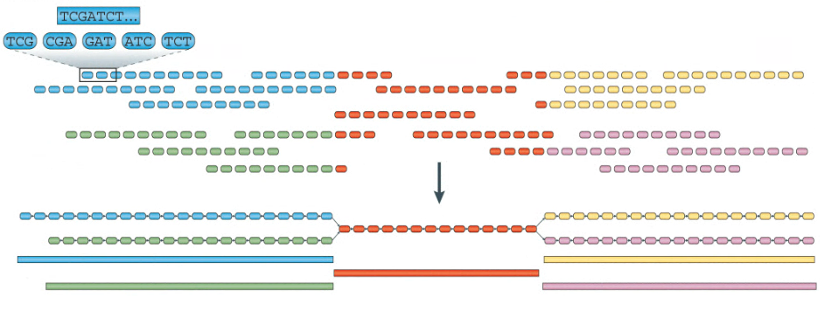
K-mer graph
Chaisson et al., (2015)

